Slide 1
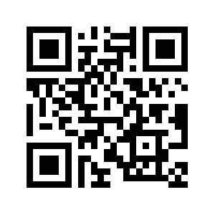

Reproducible Research
through Open Science
November 20, 2019 Supporting materials at https://osf.io/vgjpq/
Jason Pither (UBC Okanagan, Biology) & Mathew Vis-Dunbar (UBC SMP Librarian)
With additional materials from the Open Science Ambassadors Program
at the Center for Open Science
Notes:
Ask about audience, including stats background, use of R markdown etc..

Slide 2
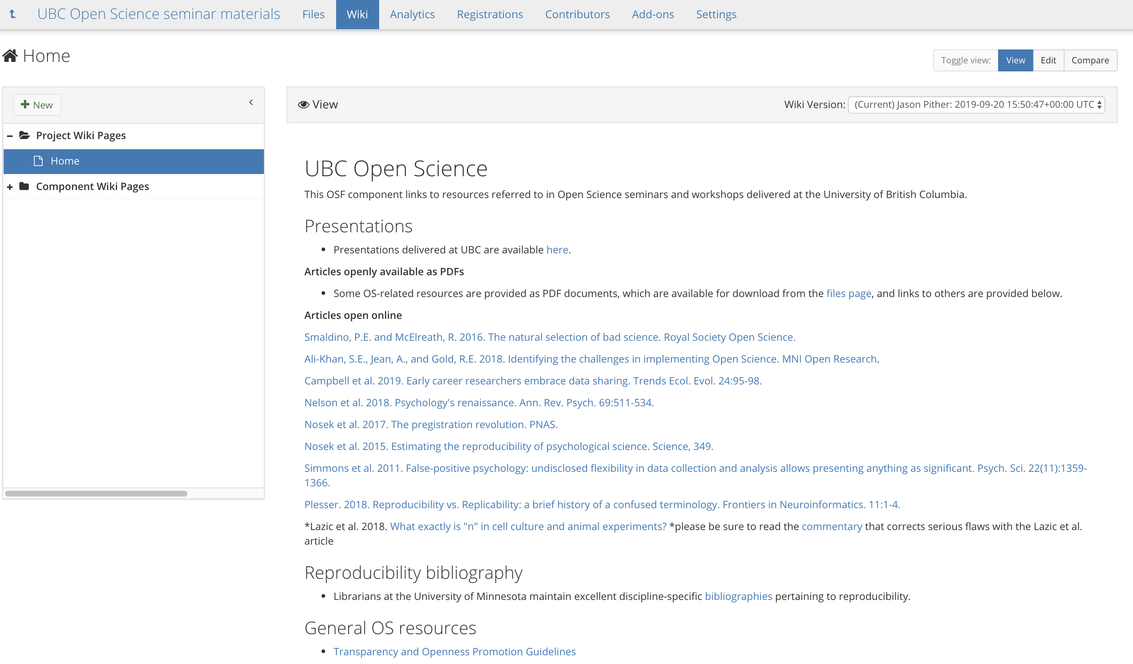

Slide 3
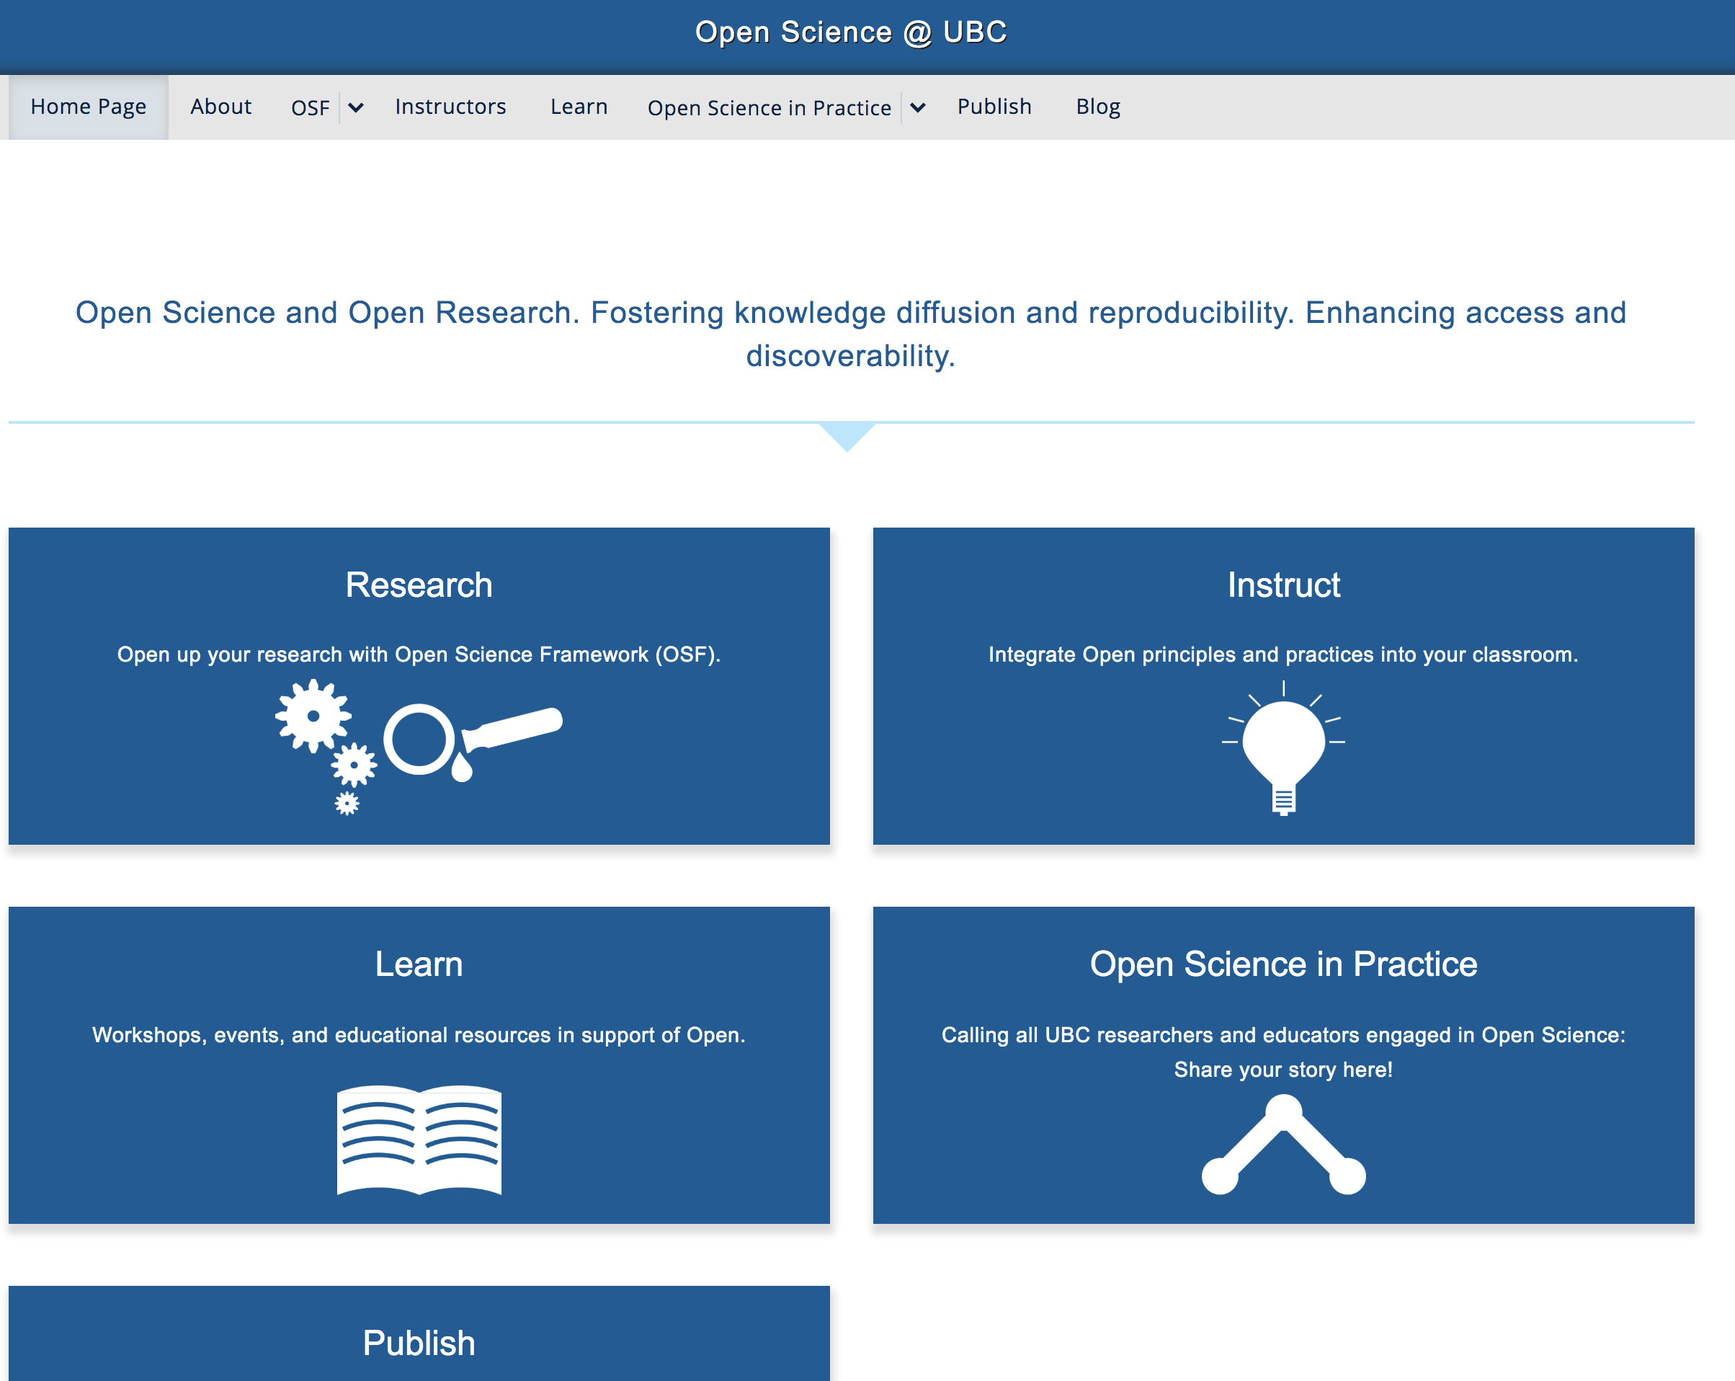
openscience.ubc.ca

Slide 4
Background
Problem
Irreproducible research
Sources of the problem
Solutions
Practices that improve reproducibility – Open Science
Other benefits of Open Science best practices
Tools that facilitate Open Science best practices
Open Science initiatives at UBC
Excellence fund strategic initiative
Okanagan pilot project
Discussion / Q&A
Overview

Slide 5
Terminology
One of many possible definitions of Open Science:
Scientific research conducted and communicated in an honest, accessible, and transparent way, such that independent researchers can reproduce the results
Background

Slide 6
Background

Slide 7
Terminology
Computational Reproducibility:
If we took your data and code/analysis scripts and reran it, we can reproduce the numbers/graphs in your paper
Methods Reproducibility:
We have enough information to rerun the experiment or survey the way it was originally conducted
Results Reproducibility/Replicability:
We reproduce the methods (as above), collect new data, and get the same statistical conclusion
Background

Slide 8
Terminology
Computational Reproducibility:
If we took your data and code/analysis scripts and reran it, we can reproduce the numbers/graphs in your paper
Methods Reproducibility:
We have enough information to rerun the experiment or survey the way it was originally conducted
Results Reproducibility/Replicability:
We reproduce the methods (as above), collect new data, and get the same statistical conclusion
Foundational to science
Background

Slide 9
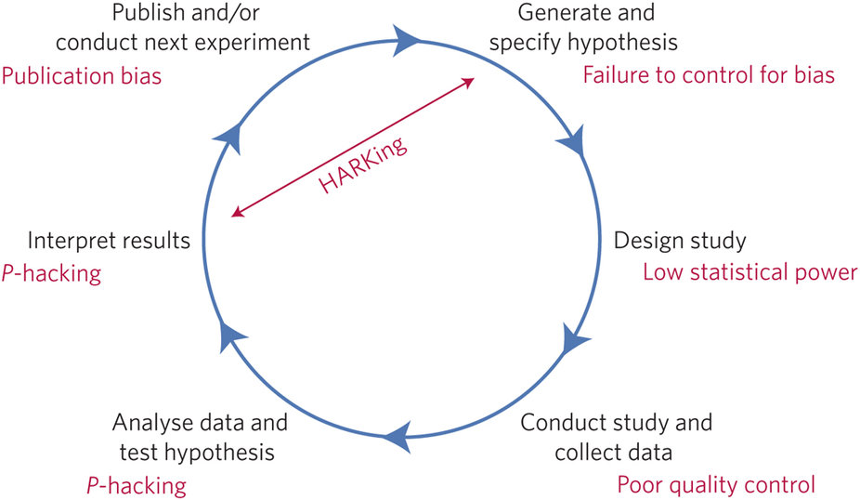
Hypothetico-Deductive Model of the Scientific Method
Note distinction between Confirmatory studies vs Exploratory studies
Background
Reference: http://www.nature.com/articles/s41562-016-0021#f1

Slide 10
Hypothetico-Deductive Model of the Scientific Method
We all strive for:
Innovative ideas
Rigorous, reproducible science
Accumulation of knowledge
Background
Reference: http://www.nature.com/articles/s41562-016-0021#f1

Slide 11
The problem
Questionable methods infiltrate the research workflow at various stages (typically unwittingly!), ultimately yielding irreproducible research.
Problem

Slide 12
Science is broken?
Problem

Slide 13
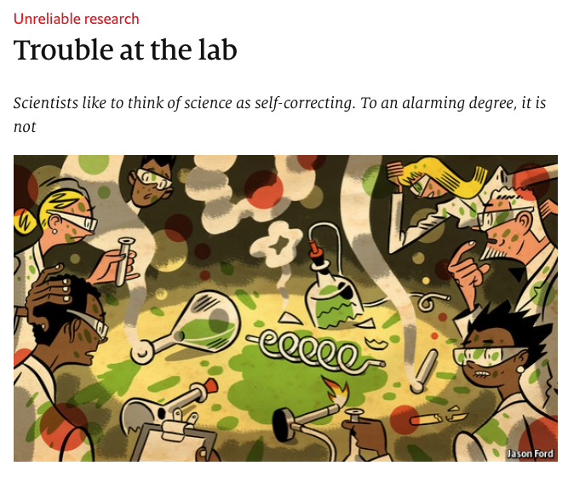

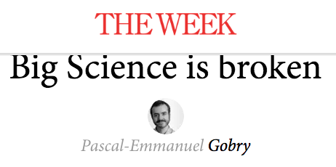
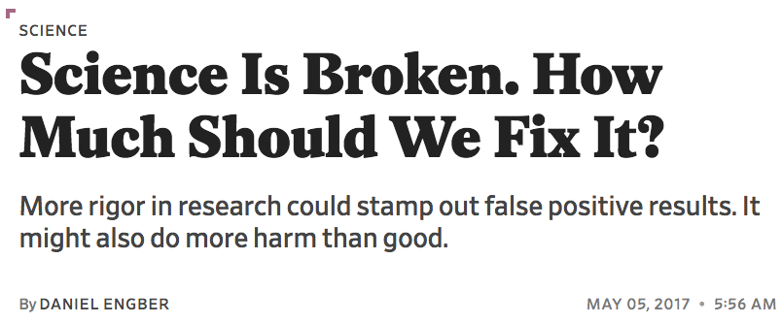

Science is broken?
https://theweek.com/articles/618141/big-science-broken

Slide 14
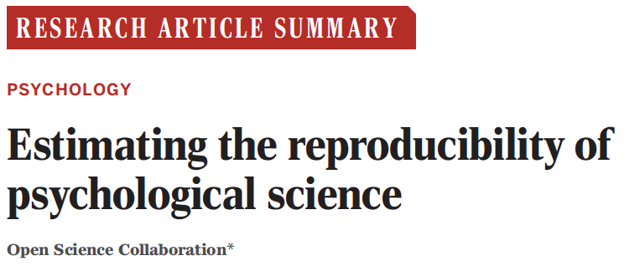
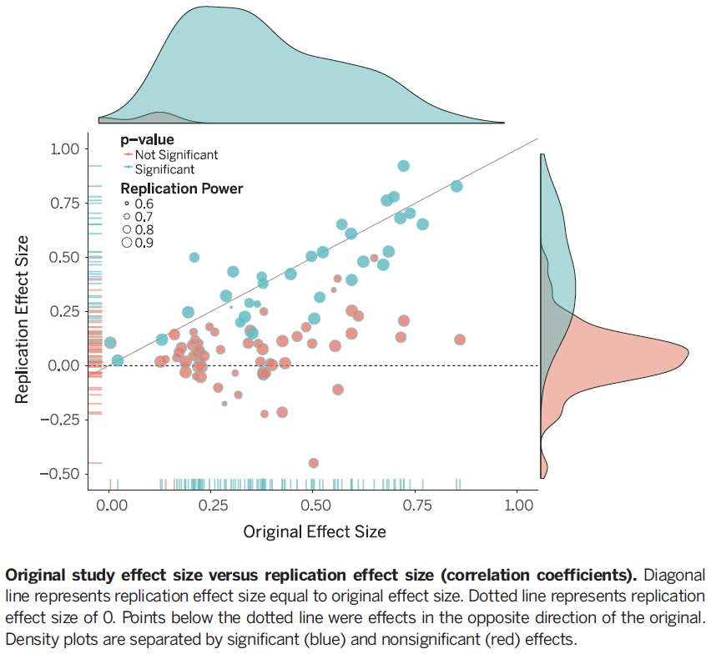
Reproducibility is not the norm
(2015)
● 100 studies published in 3 psychology journals
● Used high-powered designs and original materials
● 36% of studies were able to be reproduced
Problem

Slide 15
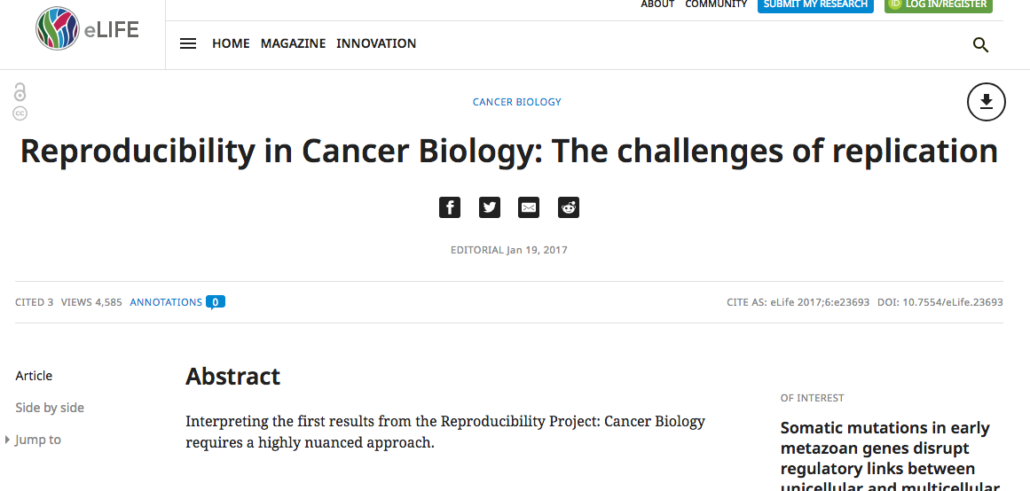
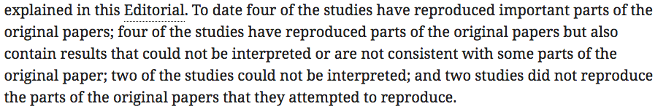
Reproducibility is not the norm
Problem

Slide 16
Sources of the problem
Sources of problem

Slide 17
Sources of the problem
Lack of replication
Analytical flexibility
Sources of problem
Reference: http://www.nature.com/articles/s41562-016-0021#f1

Slide 18
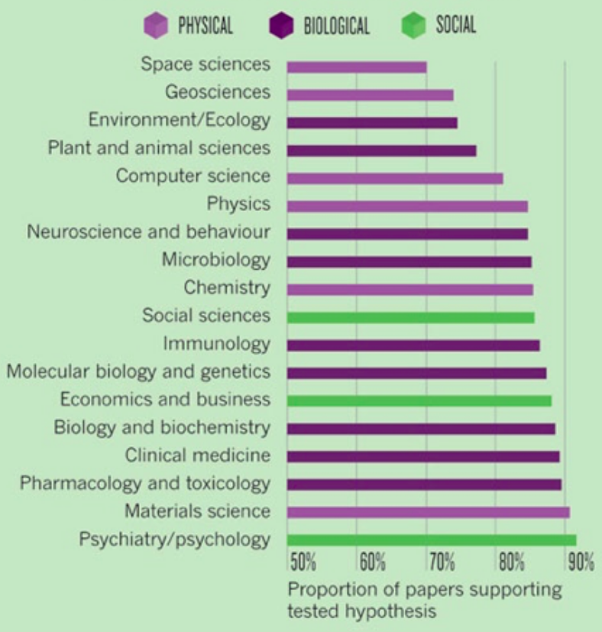

Publication bias: positive results
Positive Results
by Discipline
Fanelli D (2010) “Positive” Results Increase Down the Hierarchy of the Sciences.
PLOS ONE 5(4): e10068. CC-BY doi:10.1371/journal.pone.0010068
Sources of problem

Slide 19
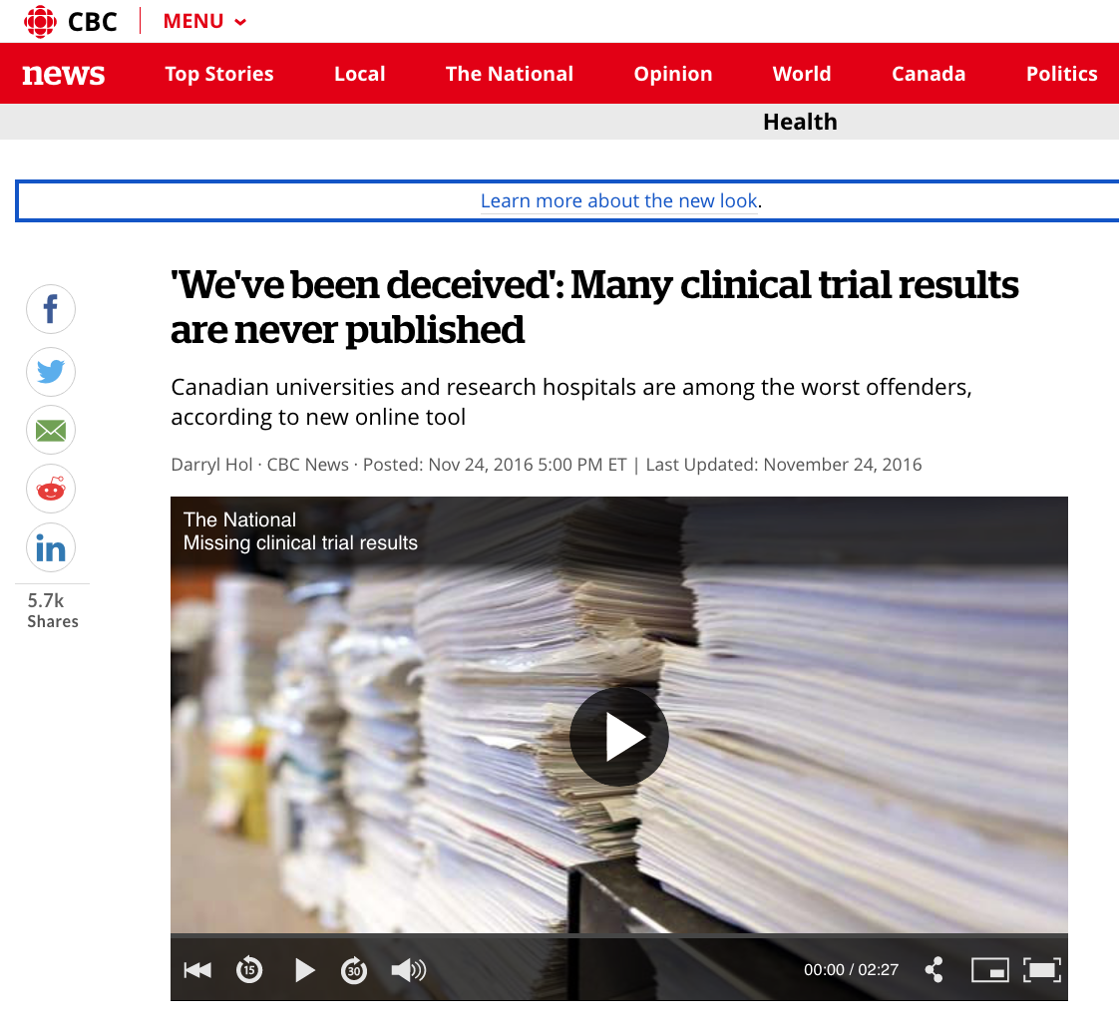
Publication bias: file drawer
Sources of problem

Slide 20
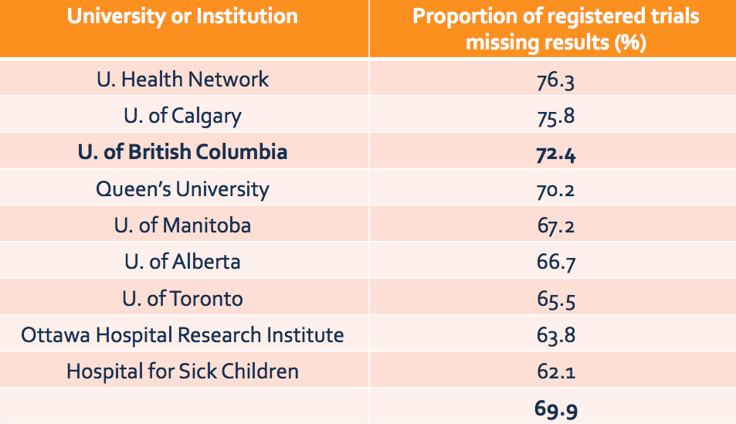
Publication bias: file drawer
Sources of problem

Slide 21
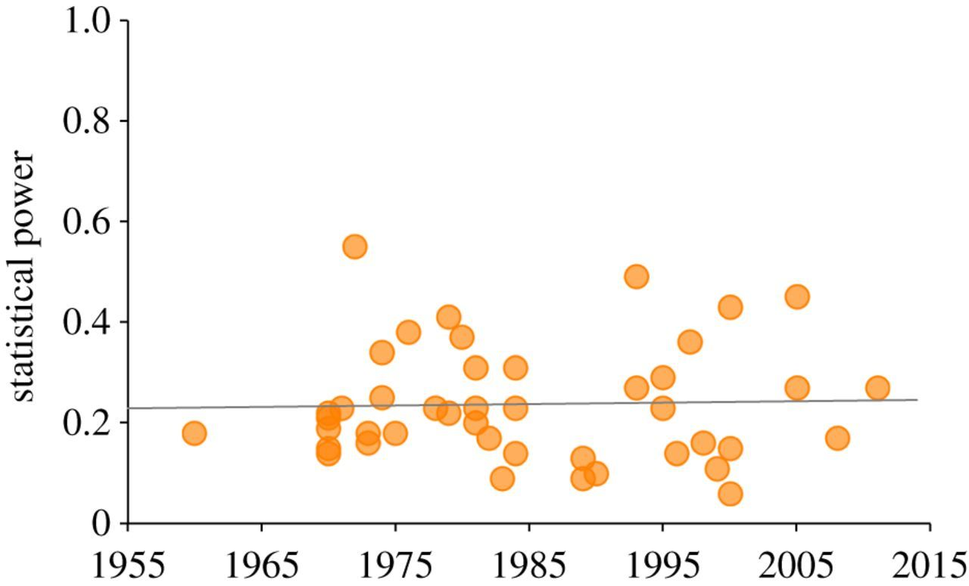
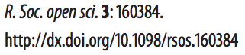
Low power
Average statistical power from 44 reviews of papers published in journals in the social and behavioural sciences between 1960 and 2011. Data are power to detect small effect sizes (d=0.2), assuming a false-positive rate of α=0.05, and indicate both very low power (mean=0.24) but also no increase over time (R²=0.00097).
Sources of problem

Slide 22
Low power
N = 49 studies

Slide 23
Low power
N = 49 studies

Slide 24
Low power
N = 49 studies
Low power studies are prone to inflated effect sizes (even if no true effect is present)!

Slide 25
Low power
Type “M” error:
Quantifies the proportion by which the critical value must exceed the effect size in order to achieve statistical significance

Slide 26
Researcher degrees of freedom
All data processing and analytical choices made after seeing and interacting with your data
Results become data dependent, and no longer adhere to the original hypothesis testing model
Sources of problem
Simmons et al. 2011. Psychological Science 22:1359-1356

Slide 27
Researcher degrees of freedom
Should more data be collected?
Should I exclude this ”outlier”? Is it an ”outlier”?
These extra variables I measured, should they be used?
This analysis seems to behave better than the other…
Which variable should I use as my main dependent variable?
How should I treat this covariate?
Sources of problem

Slide 28
Researcher degrees of freedom
Should more data be collected?
Should I exclude this ”outlier”? Is it an ”outlier”?
These extra variables I measured, should they be used?
This analysis seems to behave better than the other…
Which variable should I use as my main dependent variable?
How should I treat this covariate?
Often feel very reasonable and logical in the moment, but…
Inflates false-positive rates and P-values become uninformative
Sources of problem

Slide 29
Researcher degrees of freedom
Sources of problem

Slide 30
Inaccessible data
N = 149 randomly selected articles
Sources of problem

Slide 31
Inaccessible data
N = 149 randomly selected articles
Among the 104 articles with empirical data in which protocols or data sharing would be pertinent, 19 (18.3% [11.6% to 27.3%]) discussed publicly available data; only one (1.0% [0.1% to 6.0%]) included a link to a full study protocol.
Sources of problem

Slide 32
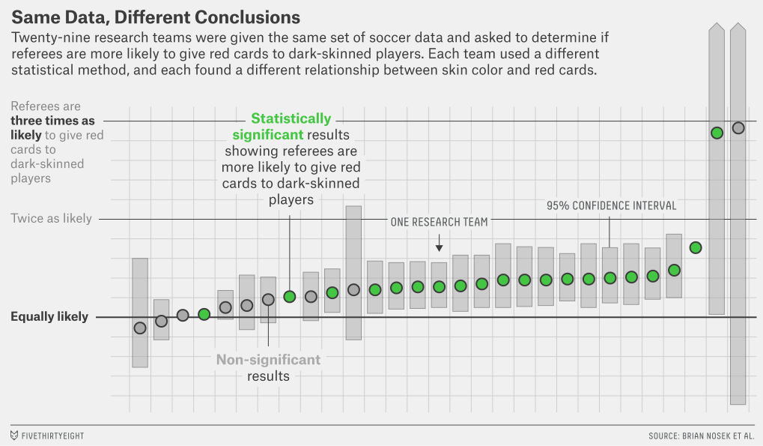
Analytical flexibility
Sources of problem
Figure credit: fivethirtyeight.com
Silberzahn et al., 2018, AMPPS

Slide 33
Note distinction between Confirmatory studies vs Exploratory studies
Sources of the problem
Lack of replication
Analytical flexibility
Sources of problem
Reference: http://www.nature.com/articles/s41562-016-0021#f1

Slide 35
A solution:
practice
Open Science
Solutions to problem

Slide 36
The workflow is key
Vast majority of the scientific workflow is obscured*
As a result:
Hard to reproduce others’ work
Hard to reproduce our own work!
Difficult to accumulate unpublished knowledge, or to use published results for additional analyses (e.g. meta-analyses)
* Some scientific disciplines (e.g. physics) better than others
Solutions to problem

Slide 37
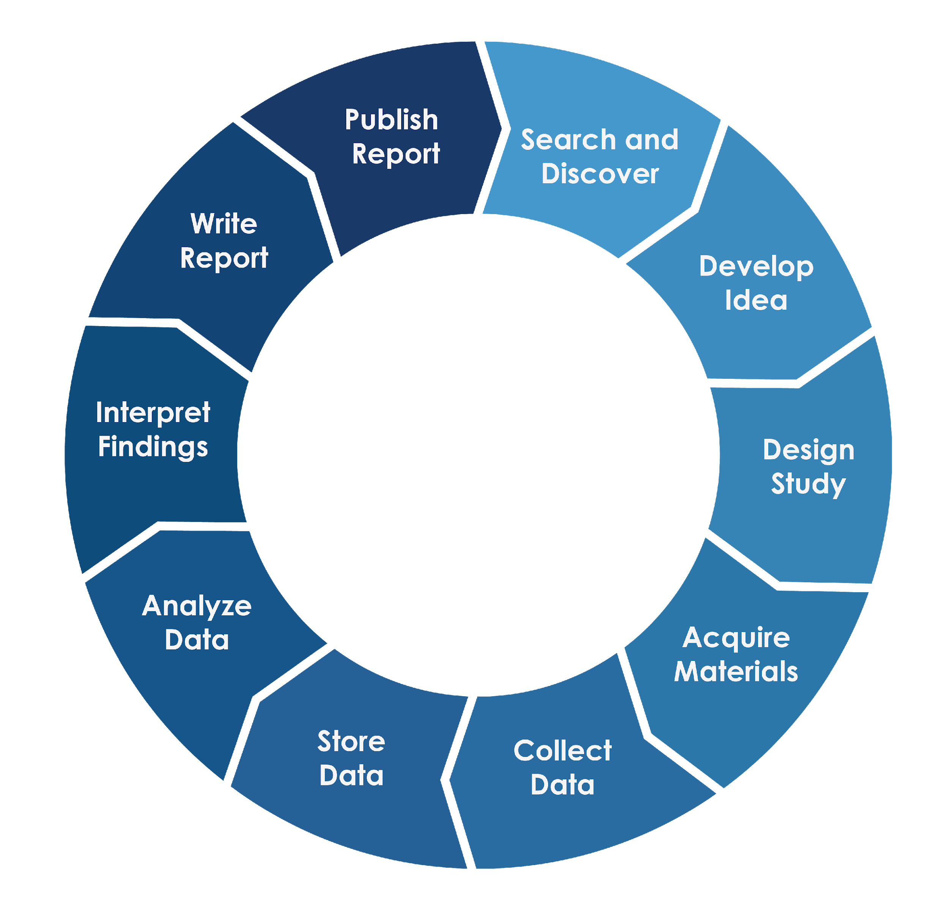
Typical workflow
Solutions to problem

Slide 38
Ideal workflow
Stage 2
Peer Review
Registered Reports
Stage 1
Pre-registration & Peer Review
“Registered report”
Solutions to problem

Slide 39
Ideal workflow
Stage 2
Peer Review
Decreases researcher d.f. Holds you accountable to yourself and others
Registered Reports
Stage 1
Pre-registration & Peer Review
“Registered report”
Solutions to problem

Slide 40
Ideal workflow
Stage 2
Peer Review
Decreases researcher d.f. Holds you accountable to yourself and others
Registered Reports
Stage 1
Pre-registration & Peer Review
“Registered report”
If registration made public: Helps replication attempts Decreases the file drawer effect
Solutions to problem

Slide 41
Ideal workflow
Stage 2
Peer Review
Decreases researcher d.f. Holds you accountable to yourself and others
207 journals have some form of RR adoption!
Registered Reports
Stage 1
Pre-registration & Peer Review
“Registered report”
If registration made public: Helps replication attempts Decreases the file drawer effect
Solutions to problem

Slide 42
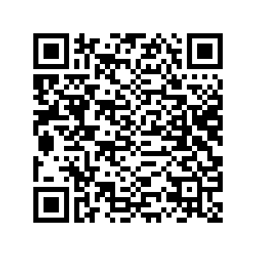
Ideal workflow
See here for list of current journals offering some form of registered report
Solutions to problem

Slide 43
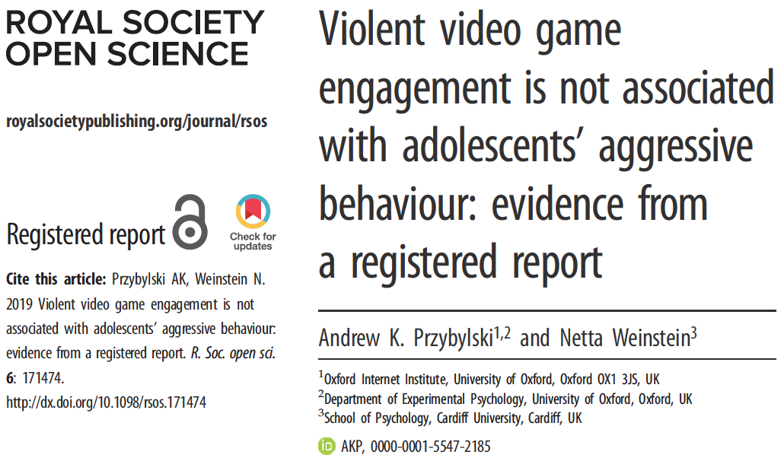
Example registered reports
Solutions to problem

Slide 44
Example registered reports
Reproducibility project: Cancer Biology
Estimating the reproducibility of psychological science
All contributing studies include registered reports.
Solutions to problem

Slide 45
Open science lite
Central to most definitions of open science:
Research workflow is transparent, open, and thoroughly documented from the start
Annotated scripts are shared
The data themselves are open*
* This is not strictly necessary to ensure reproducibility
Solutions to problem

Slide 46
Open science lite
Central to most definitions of open science:
Research workflow is transparent, open, and thoroughly documented from the start
Annotated scripts are shared
The data themselves are shared
On their own, these features go a long way towards ensuring reproducibility of research.
Solutions to problem

Slide 47
Open science lite
Central to most definitions of open science:
Research workflow is transparent, open, and thoroughly documented from the start
Annotated scripts are shared
The data themselves are shared or at least accessible
On their own, these features go a long way towards ensuring reproducibility of research.
Even better:
- Pre-register study (different from full registered report)
Solutions to problem

Slide 48
Pre-registration
Documenting your research plan in a read-only public repository before you conduct the study
At a minimum, a pre-registration should include the “what” of a study:
Research question
Target population and sample size based on power analyses or, better, estimates of Type M error
General design
Variables to be measured / dataset you’ll be using
Solutions to problem

Slide 49
Workflow for the masses
Pre-registration
Solutions to problem

Slide 50
Pre-registration
Helps reduce publication bias, specifically the “file drawer effect”, by increasing discoverability of unpublished studies.
Helps you as a researcher plan ahead more carefully, and fosters greater awareness of pitfalls associated with researcher degrees of freedom.
Focuses attention on effect sizes and reducing type M errors
Solutions to problem

Slide 51
What good is Open Science to me personally?
Benefits of Open Science

Slide 52
Benefits of Open Science

Slide 53
Benefits of adopting Open Science
Improves Efficiency
Saves time and $$
Re-use methods / code
Avoids duplication while enabling replication
Facilitates meta-analyses
Promotes accurate discovery
Benefits of Open Science

Slide 54
Benefits of adopting Open Science
Funding agencies (e.g. Tri-Council) are increasingly demanding aspects of OS (e.g. open data, open access)
OS practices are increasingly being favoured at academic institutions
Many aspects of OS will eventually be required
Benefits of Open Science

Slide 55
Tools that can help
Open Science Framework (https://osf.io)
Scripting (e.g. using R instead of Excel! R Markdown)
Git / Github (see lesson here)
Data management plan tools e.g. here
Tools that facilitate Open Science

Slide 56

Scripting using R / R Markdown, Python etc…
Open Science Framework
Tools that facilitate Open Science

Slide 57
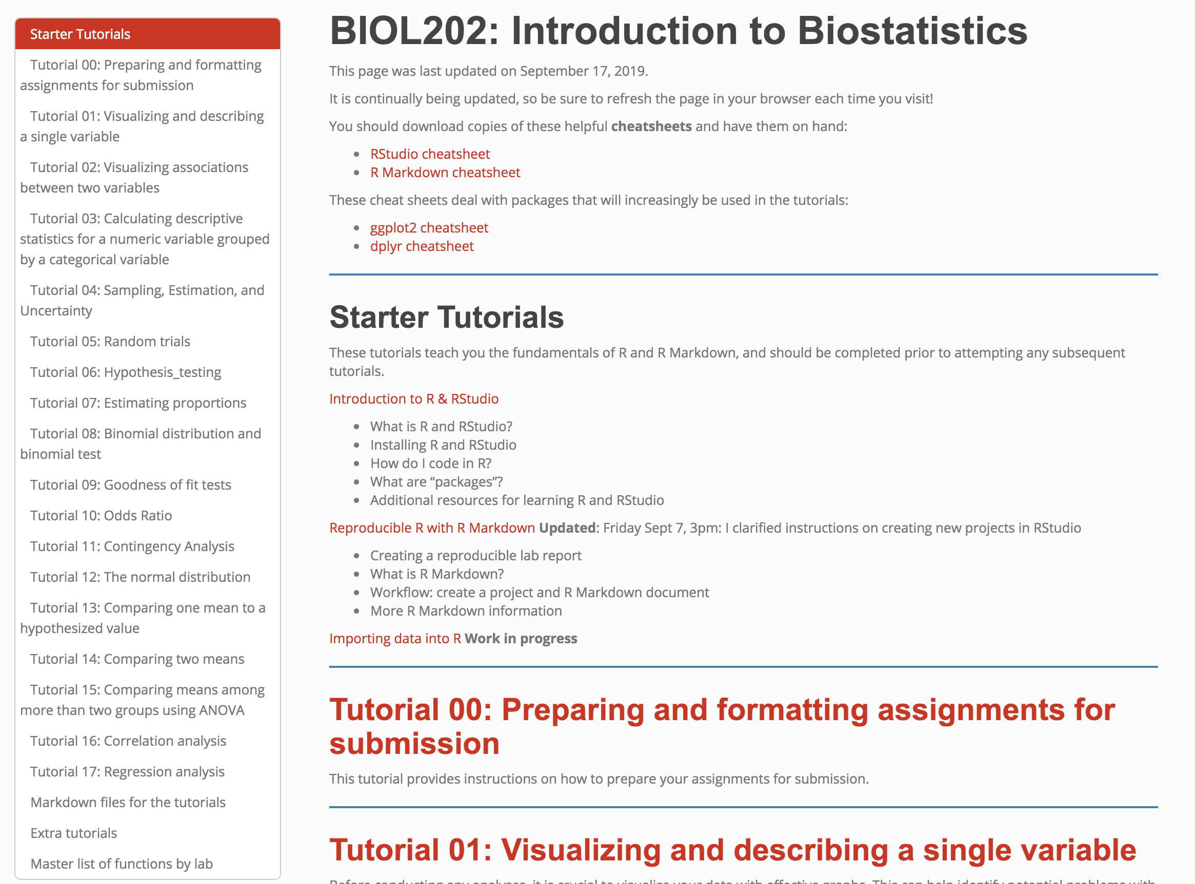
https://people.ok.ubc.ca/jpither/modules/biol202_home.html

Slide 58
Learn with simulated data!
Solutions to problem

Slide 59
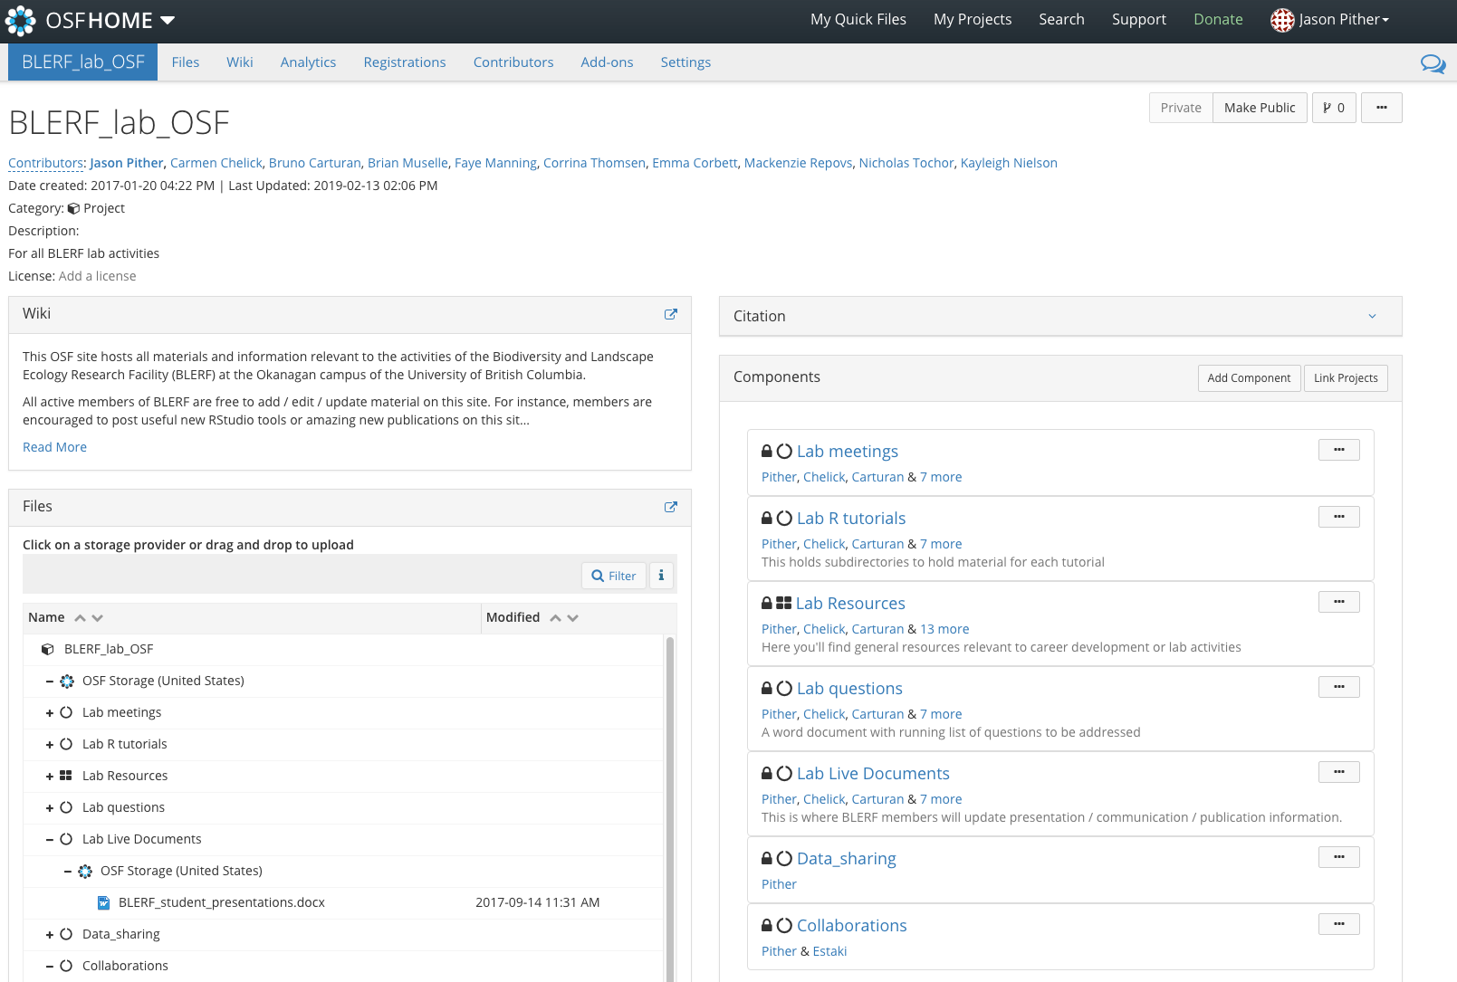
A web app to support:
Collaboration
Documentation
Archiving
Tools that facilitate Open Science

Slide 60
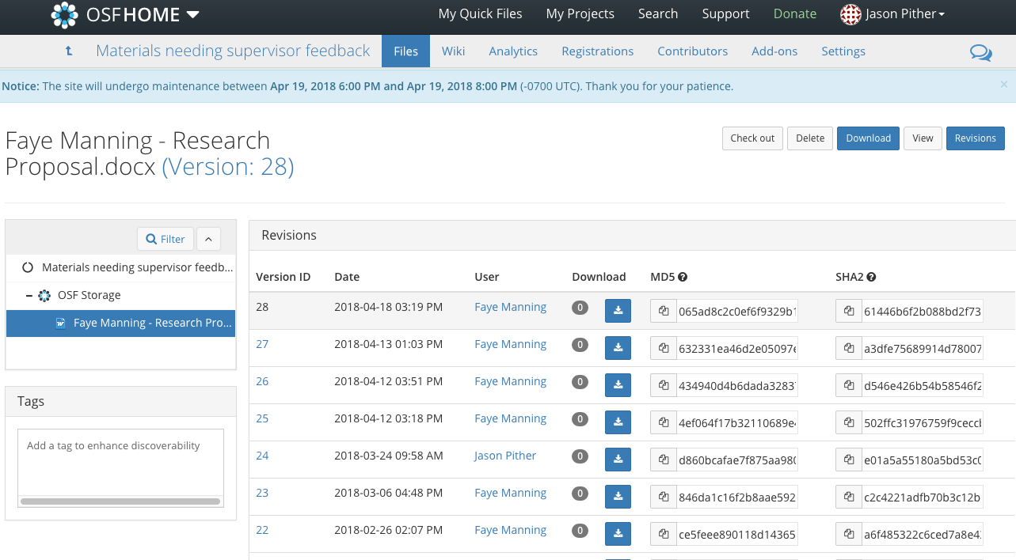
Automatic file versioning
Tools that facilitate Open Science

Slide 61
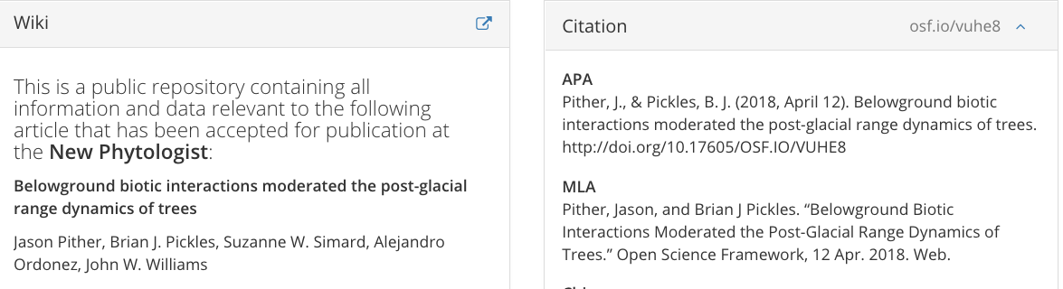
Persistent citable identifiers
Tools that facilitate Open Science

Slide 62
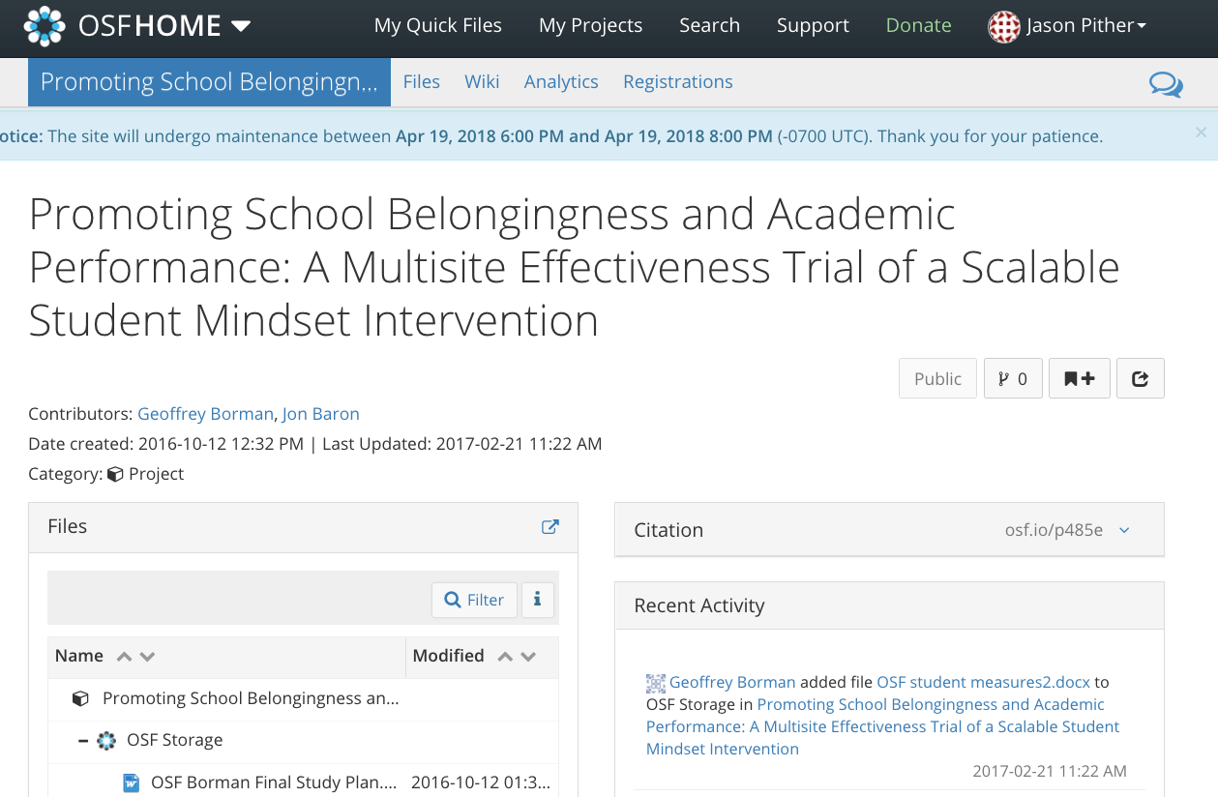
Registrations
Tools that facilitate Open Science

Slide 63
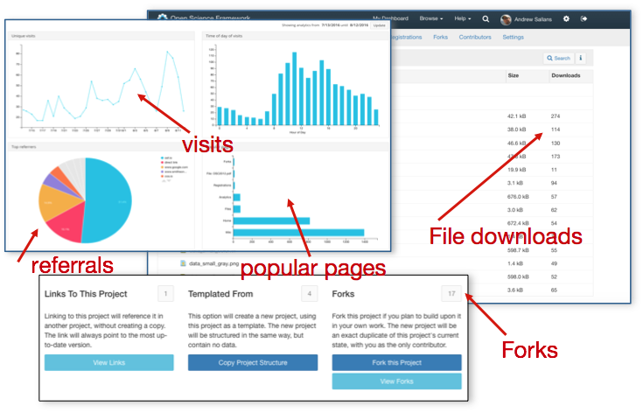
Analytics
Tools that facilitate Open Science

Slide 64
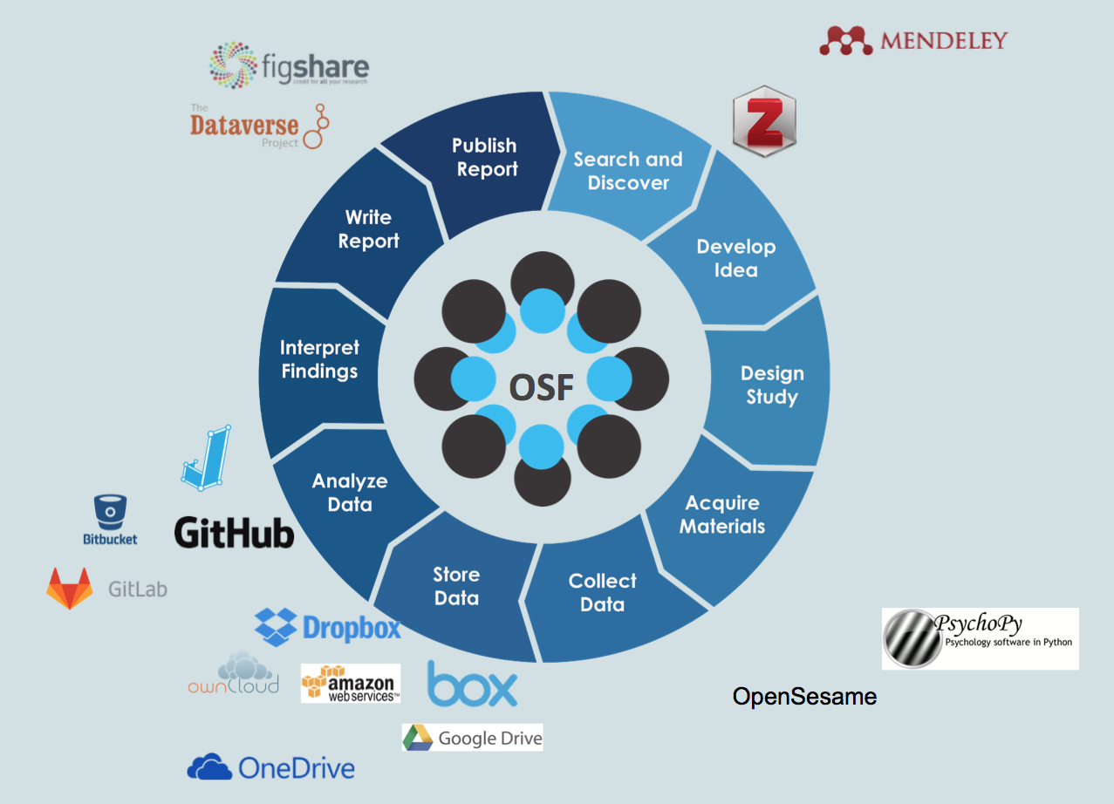
Connects services researchers use
Tools that facilitate Open Science

Slide 65
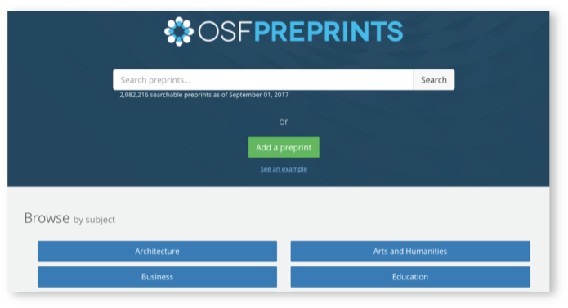
Preprint services enhance research visibility
Tools that facilitate Open Science

Slide 66

Open Science @
UBC Open Science initiatives

Slide 67
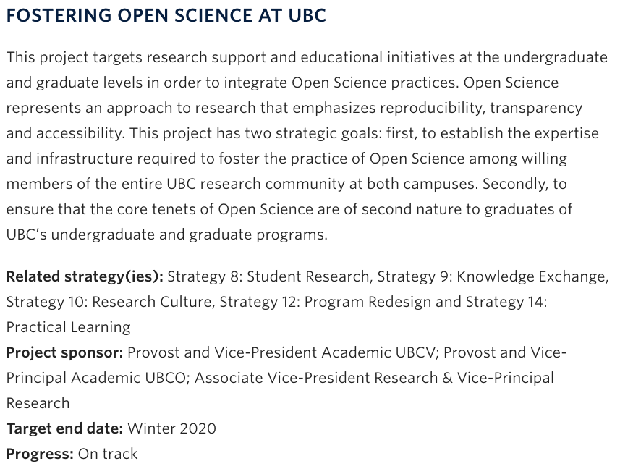
Excellence fund strategic initiative:
UBC Open Science initiatives

Slide 68
UBC-wide initiatives
Funded by UBC Excellence Fund: strategic initiative
Promoting best practices in OS throughout UBC community
Library and Advanced Research Computing developing sustainable infrastructure and expertise to support Open Science and OSF
Establishment of OSF Institutions for UBC (coming soon!)
Providing regular workshops, seminars, outreach at both campuses
Developing instructional material for credit - BIOLOGY
Engaging with Faculty Association and administration to encourage collaborative policy development
openscience.ubc.ca
UBC Open Science initiatives

Slide 69
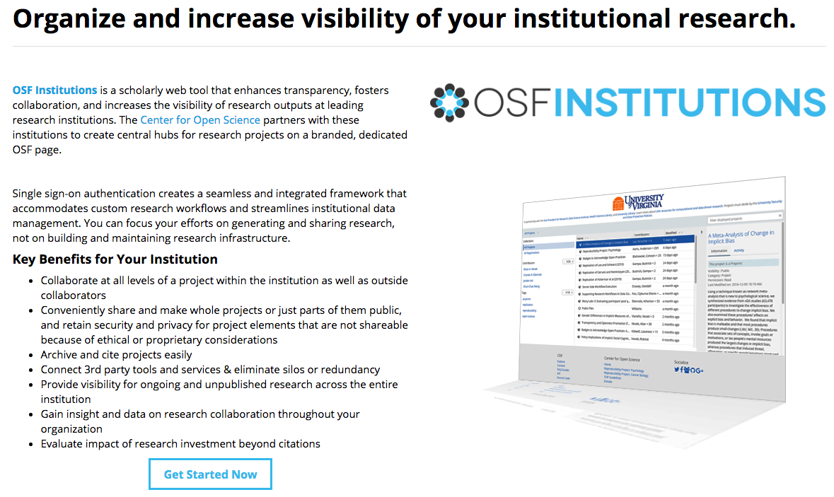
UBC Open Science initiatives

Slide 70
At UBC’s Okanagan campus
Pilot project underway
Integrating best practices in Open Science into the Biology undergraduate program. Starting with small steps...
Developing and deploying introductory instructional material regarding OS (currently in 1st year BIOL)
Uploading / archiving digital photos of lab book notes to Canvas
Teaching R Markdown in 2nd year core Biostats course (BIOL202)
Encouraging use of Markdown for upper-year lab assignments
Encouraging instructors to reward transparency and honesty
Longer-term goal
Accreditation for undergrads and grads
UBC Open Science initiatives

Slide 71
Acknowledgments
Dr. Eric Eich (Vice-Provost and AVP Academic Affairs)
Heather Berringer (Chief Librarian, Okanagan campus)
Sharon Hanna (UBCO librarian helping with OS initiatives)
Centre for Open Science (https://osf.io)
Wade Klaver (UBC ARC)
Carmen Chelick and Brian Muselle (MSc Biology students)
Department of Biology (Okanagan campus)
Steve Cundy and UBC’s Advanced Research Computing team
UBC Excellence Fund

Slide 72
Extra slides

Slide 73
Discussion points:
Early career researchers
Promotion & Tenure
How to effect change
Lab practices
Exploratory vs confirmatory data analysis
Open Access publications
eLife interactive articles

